Slide 1

Western Project Pre-Implementation Survey
Hannah DeBruin
Weekly Meeting: Transit Data Subgroup
11/21/22

Slide 2
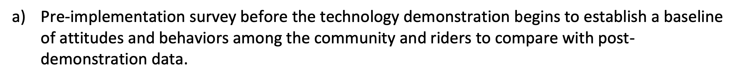
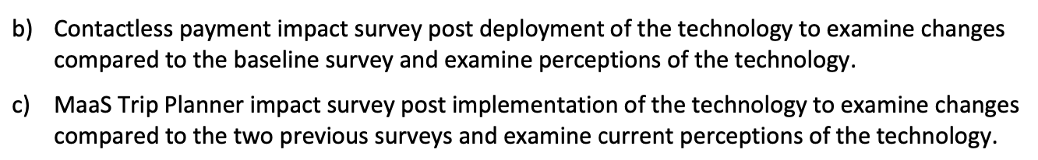
Pre-Implementation Scope
Compared to second two surveys:
Weekly Meeting (11/21/2022)
Hannah DeBruin

Slide 3
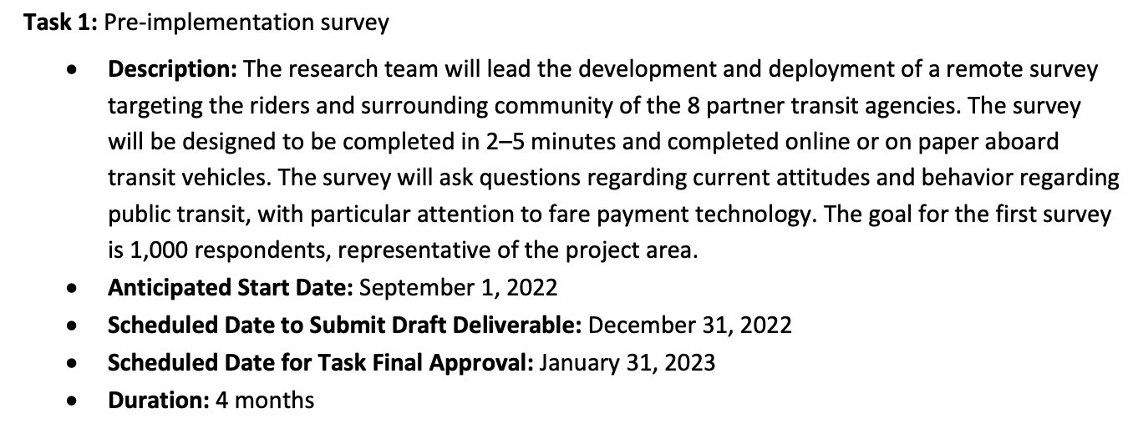
Pre-Implementation Scope
Logistic regression model?
Binary regression using cash, using contactless fare payment
Weekly Meeting (11/21/2022)
Hannah DeBruin

Slide 4
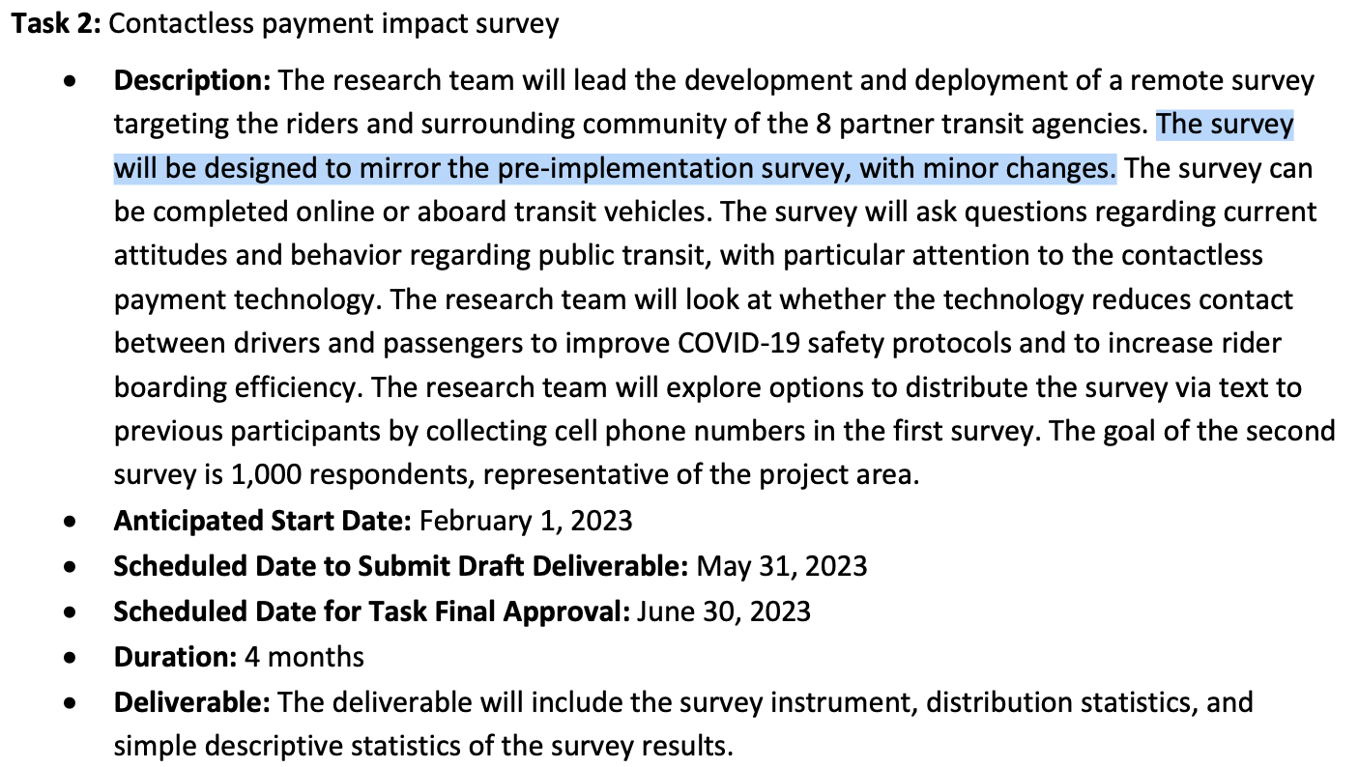
Pre-Implementation Scope
Weekly Meeting (11/21/2022)
Hannah DeBruin

Slide 5
Attitudes to Analyze
Targeting both riders and surrounding community of 8 partner transit agencies
What delivery mode? What has been discussed with office assisting us with implementation?
2-5 minutes, completed online or on paper aboard transit vehicles, second survey distributed through text to previous participants
“Current attitudes and behavior regarding public transit”
”With particular attention to fare payment technology” “whether the technology reduces contact between drivers and passengers to improve COVID-19 safety protocols and to increase rider boarding efficiency”
Goal: 1000 respondents, representative of the project area
Weekly Meeting (11/21/2022)
Hannah DeBruin

Slide 6
Attitudes to Analyze
Targeting both riders and surrounding community of 8 partner transit agencies
2-5 minutes, completed online or on paper aboard transit vehicles, second and third survey distributed through text to previous participants
Make sure to minimize number of questions
Collect cell phone numbers in first survey, for use in second and third surveys
”Current attitudes and behavior regarding public transit”
”With particular attention to fare payment technology” “whether the technology reduces contact between drivers and passengers to improve COVID-19 safety protocols and to increase rider boarding efficiency”
Goal: 1000 respondents, representative of the project area
Weekly Meeting (11/21/2022)
Hannah DeBruin

Slide 7
Attitudes to Analyze
Targeting both riders and surrounding community of 8 partner transit agencies
2-5 minutes, completed online or on paper aboard transit vehicles, second survey distributed through text to previous participants
”Current attitudes and behavior regarding public transit”
Frequency of use
Satisfaction with service
Service frequency, reliability, coverage satisfaction
Quality of buses, drivers, etc?
Ease/efficiency of payment (could be compared in second survey?)
Concern about the risk of COVID-19 on transit vehicles (could be compared in second survey?)
Access to information for trip-planning (could be compared in third survey?)
”With particular attention to fare payment technology” “whether the technology reduces contact between drivers and passengers to improve COVID-19 safety protocols and to increase rider boarding efficiency”
Goal: 1000 respondents, representative of the project area
Weekly Meeting (11/21/2022)
Hannah DeBruin
Notes:
Satisfaction survey existing

Slide 8
Attitudes to Analyze
Targeting both riders and surrounding community of 8 partner transit agencies
2-5 minutes, completed online or on paper aboard transit vehicles, second survey distributed through text to previous participants
”Current attitudes and behavior regarding public transit”
”With particular attention to fare payment technology” “whether the technology reduces contact between drivers and passengers to improve COVID-19 safety protocols and to increase rider boarding efficiency”
Smartphone ownership, data plan restrictions
Banked status (access to savings account, checking account, debit card, credit card, prepaid/gift card, paypal/venmo/cash app) (use of contactless tap card payment since pandemic?)
Current payment method, comfort with contactless payment methods (ie sharing card information on website/app to buy fares), if cash wasn’t allowed in the future, what would they switch to?
Analysis should look at importance of fare payment in decision to use transit vs other factors
Goal: 1000 respondents, representative of the project area
Weekly Meeting (11/21/2022)
Hannah DeBruin

Slide 9
Attitudes to Analyze
Targeting both riders and surrounding community of 8 partner transit agencies
2-5 minutes, completed online or on paper aboard transit vehicles, second survey distributed through text to previous participants
”Current attitudes and behavior regarding public transit”
”With particular attention to fare payment technology” “whether the technology reduces contact between drivers and passengers to improve COVID-19 safety protocols and to increase rider boarding efficiency”
Goal: 1000 respondents, representative of the project area
Demographic information (age, gender, race, ethnicity, education level, employment status, income level, primary language, disability) (zip code?)
Weekly Meeting (11/21/2022)
Hannah DeBruin

Slide 10

Contactless Fare Payment Resource from CTS Conference
Email Yingling Fan to request summary of results from our study area? Ask if there were any questions the team wishes they would’ve asked?
Weekly Meeting (11/21/2022)
Hannah DeBruin

